Slide 1
RADseq Pipelines: an overview

Slide 2
NGS Non-model organisms Bioinformatics Workflow
Quality Filtering
Process of taking raw reads and trimming off bad quality bases
Can also involve demultiplexing
De Novo Assembly
Process of determining one representative sequence per locus
Think of assembling a reference genome
Process can be skipped if reference exists
Read Mapping
Process of mapping trimmed reads to the reference
SNP Calling
Process uses the number of mapped reads to genotype SNPS
Some programs will also genotype INDels and complex variants
When combined with a de novo reference, this is also SNP discovery
SNP Filtering
Process of removing false positives from the data set

Slide 3
NGS Non-model organisms Bioinformatics Workflow

Slide 4
NGS Non-model organisms Bioinformatics Workflow

Slide 5

The pipelines
Stacks (Catchen et al. 2013)
The first mainstream RADseq software
Designed specifically for mbRAd but can handle ddRAD
dDocent (Puritz et al. 2014)
Simple customizable backbone for bioinformatics
Designed specifically for ddRAD and ezRAD
pyRAD (Eaton 2014)
Analysis pipeline written in python
Can handle many RADseq types, focused on phylogentics
aftrRAD (Sovic et al. 2015)
Newest kid on the blog
Offers a blend between Stacks and pyRAD

Slide 6
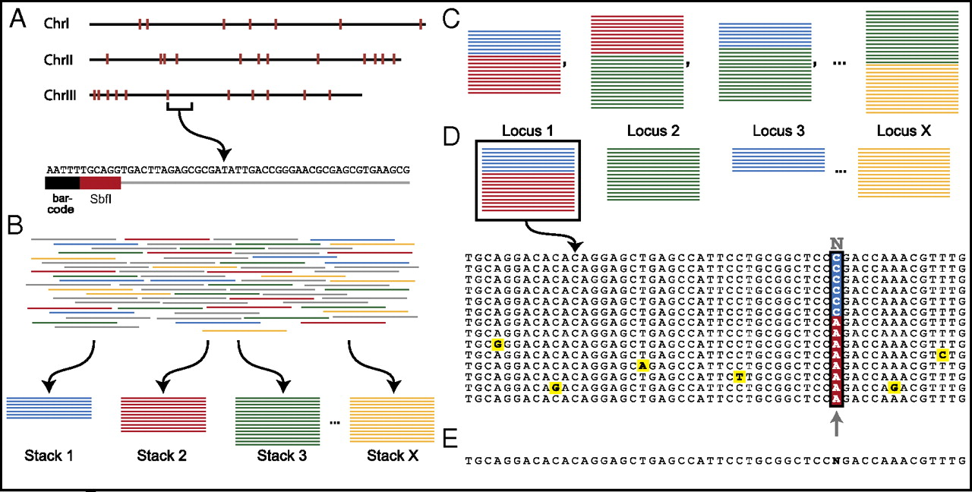
The Stacks Model
Adopted from Emerson et al. 2010
pyRAD and aftrRAD have a similar methodology except that they perform alignments along with clustering.

Slide 7
dDocent: ddRAD Analysis Pipeline
Quality Filtering
De Novo Assembly
dDocent is a customizable BASH pipeline that follows the traditional NGS bioinformatic workflow
Specifically designed to handle high levels of polymorphism
Can handle INDEL polymorphisms
It uses a novel data reduction method to help with reference assembly
It uses BWA for mapping and FreeBayes for Variant calling
Read Mapping
SNP Calling
SNP Filtering

Slide 8
Stacks
Advantages
Disadvantages
By far the most developed software option.
Syncs with a MySQL database
Can handle reference based analysis or de novo assembly
Can output multiple formats
The de novo assembly method cannot handle INDEL variation at all.
Reads with INDELs will not cluster together
Reads must remain a fixed length, so low quality reads are removed instead of trimmed
Does not call SNPs in PE reads
Has a single sample, single base pair model for SNP calling
rxstacks does improved SNP calls

Slide 9
dDocent
Advantages
Disadvantages
Performs read trimming and is INDEL aware for assembly and read mapping
Follows a stepwise, traditional NGS workflow
Has a novel data reduction method for de novo assembly
Open source BASH code that is easy to customize
Currently the final output is limited to VCF files.
Requires several different software dependencies and can be difficult to install.
Limited by the development of dependent packages

Slide 10
pyRAD
Advantages
Disadvantages
Flexible package designed to handle multiple different RADseq methods
Open source, easy to read python code
Performs clustering and alignment, so INDELS are properly handled
Can output several different output types directly
Cannot handle a reference genome. Only does de novo assembly
Has a single sample, single base pair model for SNP calling
Is designed mostly for phylogenetics

Slide 11
aftrRAD
Advantages
Disadvantages
Performs clustering and alignment, so INDELS are properly handled
Is tuned to be more sensitive than pyRAD for polymorphic loci
Output can be converted to a variety of formats
Cannot handle a reference genome. Only does de novo assembly
Has a single sample, single base pair model for SNP calling

Slide 12

RADseq Bioinformatic Challenges

Slide 13

Assemblin’ ain’t easy
RAD de novo assembly challenges:
Reads often do not overlap
Reads are often much shorter than genomic fragments
Sequencing errors, PCR errors
Data sets are large and diverse with multiple alleles per locus
Notes:
The figure on the right is a haplotype network from one simulated rad locus (80 individuals) to demonstrate the complexity of data. Imagine scaling this up to 20,000 loci.
There’s reason inbred lines are selected for genome assemblies!

Slide 14
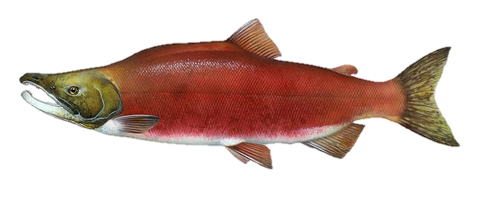
RAD de novo assembly artifacts
Over-clustering
Possible causes:
Paralogs
Polyploidy
Relatively easy to detect
High levels of coverage and heterozygosity
> 2 haplotypes per individual

Slide 15
RAD de novo assembly artifacts
Over-clustering
Small percentage of loci, even with liberal assembly parameters
Ilut et al. (2014)
Harvey et al. (2015)

Slide 16
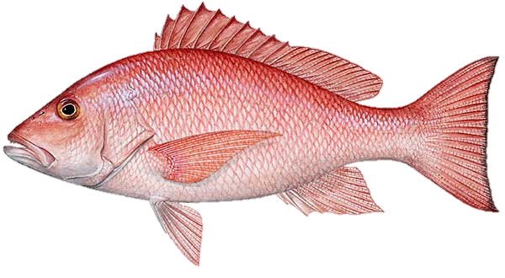
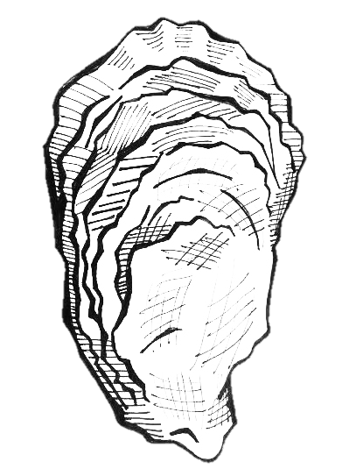
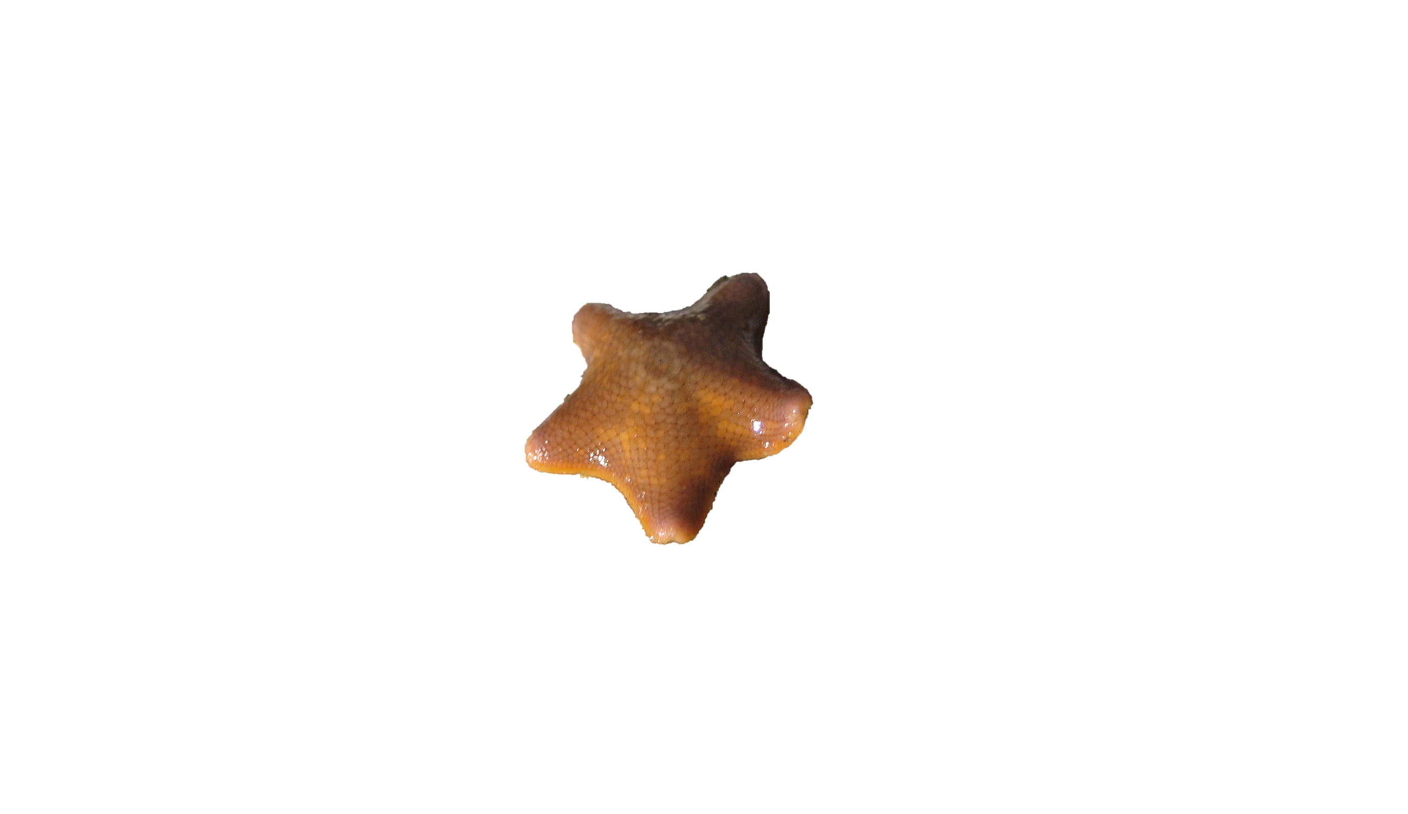
RAD de novo assembly artifacts
Over-splitting
Possible causes:
Divergent alleles
Ancestral polymorphisms
Introgression
INDELs
Difficult to detect
Appear to be homozygous loci

Slide 17


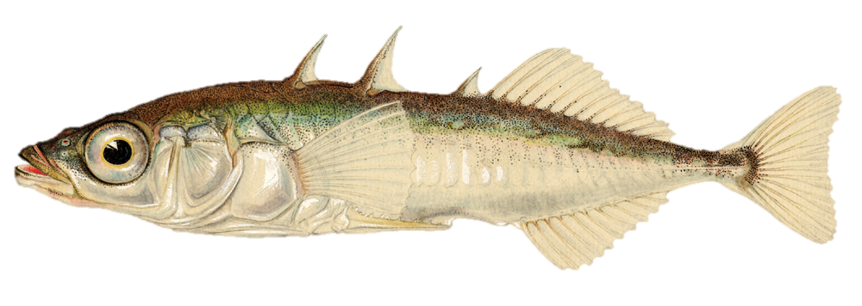
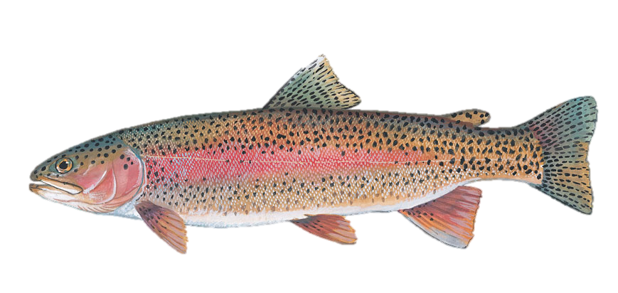
Toppling Stacks
Catchen et al. 2013. Molecular Ecology.
The default de novo assembly method does not handle INDEL variation well.
Reads with INDELs will not cluster

Slide 18
dDocent: RADseq Analysis Pipeline
Quality Filtering
De Novo Assembly
dDocent is a customizable BASH pipeline that follows the traditional NGS bioinformatic workflow
Specifically designed to handle high levels of polymorphism
Can handle INDEL polymorphisms
It uses a novel data reduction method to help with reference assembly
Read Mapping
SNP Calling
SNP Filtering

Slide 19
The effects of INDELs and over-splitting on population genetic inference from RAD sequencing
MIND THE GAP

Slide 20

Simulated RAD datasets
simrrls (version 1.5) by Deren Eaton https://github.com/dereneaton/simrrls
t=10
t=5
t=0
50
25
5
Two different levels of polymorphism: ⍬ = 0.005 and ⍬ = 0.001
Three different probabilities of INDEL polymorphism: 0.01, 0.05. 0.1

Slide 21

Simulated RAD datasets
simrrls (version 1.5) by Deren Eaton https://github.com/dereneaton/simrrls
t=10
t=5
t=0
150
100
50
Added a third level of polymorphism: ⍬ = 0.003

Slide 22

Assembly of 1000 simulated ddRAD loci
dDocent
pyRAD
aftrRAD
Stacks
PE
SE
PE
SE
Gapped
Default
1% INDELs
5% INDELs
10% INDELs
Notes:
Assembly parameters were varied for 7 different versions of RADseq pipelines:
dDocent 2.19 - Paired-end and Single-end
pyRAD 3.0.66- Paired-end and Single-end
aftrRAD 5.0
Stacked v1.40 Using the default ungapped assembly method and new gapped assembly method
Note how the scales on each graph change.

Slide 23

Assembly of 1000 simulated ddRAD loci
dDocent
pyRAD
aftrRAD
Stacks
PE
SE
PE
SE
Gapped
Default
1% INDELs
5% INDELs
10% INDELs
Notes:
The pattern is similar if using a 5% cutoff. Past 1% INDELs Stacks

Slide 24

Results
How sensitive are various RADseq pipelines to over-splitting?
dDocent-PE provides the most accurate de novo assemblies
dDocent-SE and both pyRAD are moderately sensitive to INDELs
Both versions of Stacks are highly sensitive to INDELs

Slide 25

Key differences in RAD assembly strategies
Stacks (Catchen et al. 2013), pyRAD (Eaton et al. 2014)
Cluster reads within individuals into loci
Call SNPs in loci within individuals
Cluster loci across individuals
dDocent (Puritz et al. 2014)
Remove reads below a within individual coverage level
Remove reads below an among individual coverage level
Cluster reads by aligned sequence similarity*
aftrRAD (Sovic et al. 2015)
Remove reads below a coverage cutoff
Match allelic pairs of reads
Merge allelic pairs that share a read into loci

Slide 26

For assembly, less is more
Simulated RAD locus
4,776 reads
225 unique sequences

Slide 27


Sequences with > 1X coverage
Simulated RAD locus
4,588 reads
35 unique sequences

Slide 28

Sequences with >1X coverage, >1 individual
Simulated RAD locus
4,487 reads
12 unique sequences

Slide 29

Sequences with >1X coverage, >3 individuals
Simulated RAD locus
4,059 reads
6 unique sequences

Slide 30
Results
How sensitive are various RADseq pipelines to over-splitting?
dDocent-PE provides the most accurate de novo assemblies
dDocent-SE and both pyRAD are moderately sensitive to INDELs
Both versions of Stacks are highly sensitive to INDELs
What are the effects of over-split loci on estimates of population genetic structure?

Slide 31
Effects of over-splitting on heterozygosity and F_{ST}
dDocent-R
Stacks-R
Notes:
Because I used non-equilibrium simulations, it’s difficult to predict exact values for popgen parameters. To infer estimates from RADseq data that is unbiased from reference assembly, I created a perfect reference with one read per locus and then mapped reads to the reference. These alignments were then passed to dDocent and Stacks. These will be used as our expected values.

Slide 32
Effects of over-splitting on heterozygosity and F_{ST}
dDocent-R
Stacks-R
⍬ = 0.003, INDELs = 5%

Slide 33
Effects of over-splitting on heterozygosity and F_{ST}
dDocent-R
Stacks-R
dDocent
pyRAD
⍬ = 0.003, INDELs = 5%
Notes:
Notice how pyRAD and dDocent largely capture the same pattern as our reference data sets

Slide 34
Effects of over-splitting on heterozygosity and F_{ST}
dDocent-R
Stacks-R
dDocent
Stacks-G
pyRAD
Stacks
⍬ = 0.003, INDELs = 5%
Notes:
Notice the the truncation of Heterozygosities observed in both Stacks versions. AftrRAD is extremely similar but not pictured.

Slide 35
Results
How sensitive are various RADseq pipelines to over-splitting?
dDocent-PE provides the most accurate de novo assemblies
dDocent-SE and both pyRAD are moderately sensitive to INDELs
Both versions of Stacks are highly sensitive to INDELs
What are the effects of over-split loci on estimates of population genetic structure?
Over-splitting loci negatively biases estimates of observed heterozygosity

Slide 36

RAD de novo assembly artifacts
Over-splitting

Slide 37
Percent error of F_{ST} across all simulations
Notes:
Across all pipelines, as expected FST decreases, the accuracy of FST estimates increases. However, pipelines subjected to overspitting (Stacks, Stacks-G, and aftrRAD) fair much worse.

Slide 38
RAD de novo assembly artifacts
Over-splitting
Actual
Estimated
Notes:
You can imagine this happens when alleles are only partially split (i.e. only one rare allele is removed from heterozygous genotypes). This leads to an artificial increase in the allele that is left as it is inferred to be a homozygote

Slide 39
Effects of over-splitting on minor allele frequency

Slide 40
Results
How sensitive are various RADseq pipelines to over-splitting?
dDocent-PE provides the most accurate de novo assemblies
dDocent-SE and both pyRAD are moderately sensitive to INDELs
Both versions of Stacks are highly sensitive to INDELs
What are the effects of over-split loci on estimates of population genetic structure?
Over-splitting loci negatively biases estimates of observed heterozygosity
Over-splitting loci introduces error into estimates of F_{ST}, especially at lower levels of population structure

Slide 41
Implications
De novo RAD assemblies need to be properly optimized!
Previous published results from assemblies without alignment need to be interpreted with caution
Especially in higher gene flow species
IN =
OUT
Notes:
That’s not icecream!

Slide 42
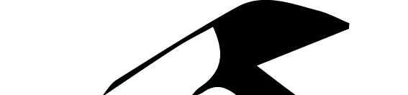
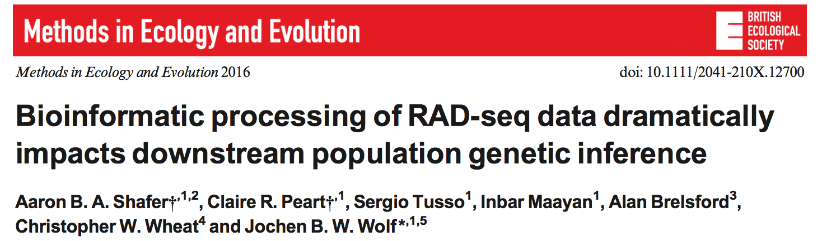
Shafer et al. 2016

Slide 43
Shafer et al. 2016
They observed large differences between reference-based and de novo approaches, the former generally calling more SNPs and reducing F_{IS} and T_{s}/T_{v}.
The site frequency spectrum was highly sensitive to the chosen approach and null expectations were best met by reference-based approaches, although contingent on the specific criteria.
Recommend that RADseq studies employ reference-based approaches to a closely related genome

Slide 44
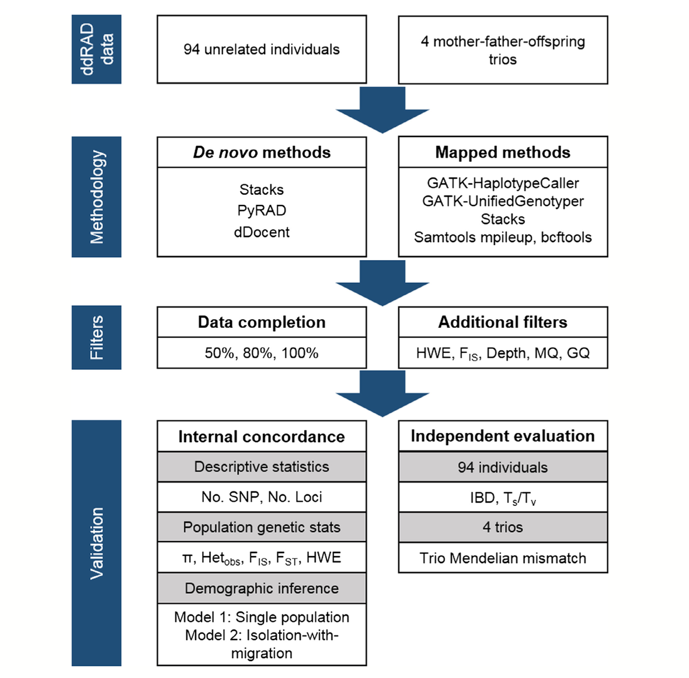
Shafer et al. 2016

Slide 45
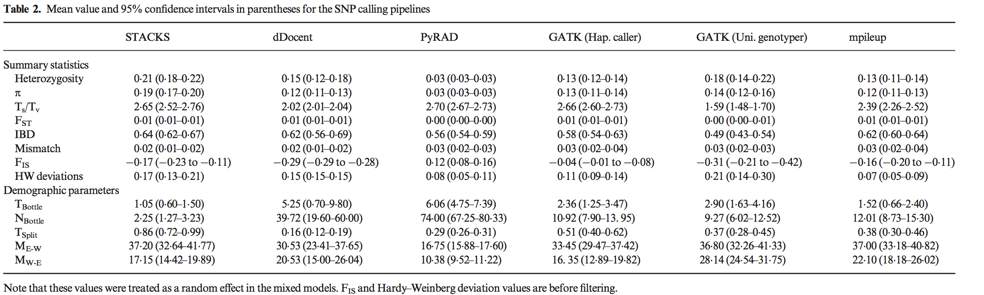
Shafer et al. 2016

Slide 46
Issues with Shafer et al. 2016
Filtering was not the same across all pipelines
De novo assemblies were not optimized
2 assembly iterations for STACKS
6 for pyRAD
1 for dDocent
Across de novo pipelines, filtering was NOT equivalent
The -m parameter in STACKS and the depth of cluster parameter for pyRAD would have lead to the de novo pipelines including SNPs with different minimum genotype depths.
3 or 8 for STACKS
3, 6, or 8 for pyRAD
dDocent, as configured, would have included SNPs with 1X coverage.
All pipelines should have had the same minimum depth parameter (5x) as the reference based pipelines.

Slide 47
Issues with Shafer et al. 2016
Trimmed reads should not be used as input for dDocent.
dDocent has an assembly module for merged reads that wasn’t used
dDocent also has a reference based approach that wasn’t used

Slide 48
These aren’t the loci you are looking for: principles of effective SNP filtering
﻿Shannon J. O'Leary, Jonathan B. Puritz, Stuart C. Willis, Christopher M. Hollenbeck, David S. Portnoy
Molecular Ecology Resources

Slide 49
SNP Filtering
Use the
Fear
Of
Reaching
Conclusions
Erroneously
BIO 594

Slide 50
SNP Filtering
VCF files output directly from genotyping software are often filled with false positives
Most software is focused more on the power to detect variants rather than accuracy
This helps to ensure that all possible variants in a data set are recovered
Filtering is required to remove false positives
BIO 594

Slide 51
Principles of SNP Filtering
What do you need to filter?
Low coverage genotypes
genotype depth
Low coverage individuals
INDELs
*Low minor allele frequency*
loci present in only a few individuals
Loci that are not called in a majority of individuals
HWE
BIO 594

Slide 52
Principles of SNP Filtering
What do you need to filter?
Loci with skewed allelic balance at heterozygotes
Loci with abnormally high depth
SNPs that are called from both Forward and Reverse reads
Loci without matching paired read status
Loci with skewed ratios of read mapping qualities
Loci with artificially high quality scores
BIO 594

Slide 53
SNP Filtering Software
VCF files can be filtered using grep, awk, and sed for particular filtering flags
http://www.1000genomes.org/wiki/Analysis/Variant%20Call%20Format/vcf-variant-call-format-version-41
vcfilb
https://github.com/ekg/vcflib
vcfallelicprimatives
important to decompose complex variants
VCFtools
http://vcftools.sourceforge.net
SNPfiltR
https://devonderaad.github.io/SNPfiltR/
rad_haplotyper
https://github.com/chollenbeck/rad_haplotyper
BIO 594

Slide 54
Exercises and Assignments
Filter.Ex is in your $PATH
Reproduce the SNPfilterR vignette
https://devonderaad.github.io/SNPfiltR/articles/reproducible-vignette.html
Assignment on Github
https://github.com/jpuritz/BIO_594_2023/blob/main/Exercises_ProbSets/Week11/Exercise.Week11.md
Please come to class prepared to discuss the required readings
BIO 594

